Slide 1
WEATHER FORECASTING
Presented By:
Vanshika

Slide 2
Contents
Introduction
Procedures
Types of weather forecasting
Tools in weather forecasting
Weather satellites
Conclusion
Source

Slide 3
Introduction of weather forecasting
Weather forecasting is the application of science and technology to predict the conditions of the atmosphere for a given location and time
Example: The degree to which it is hot or cold, wet or dry, calm or stormy, clear or cloudy.

Slide 4
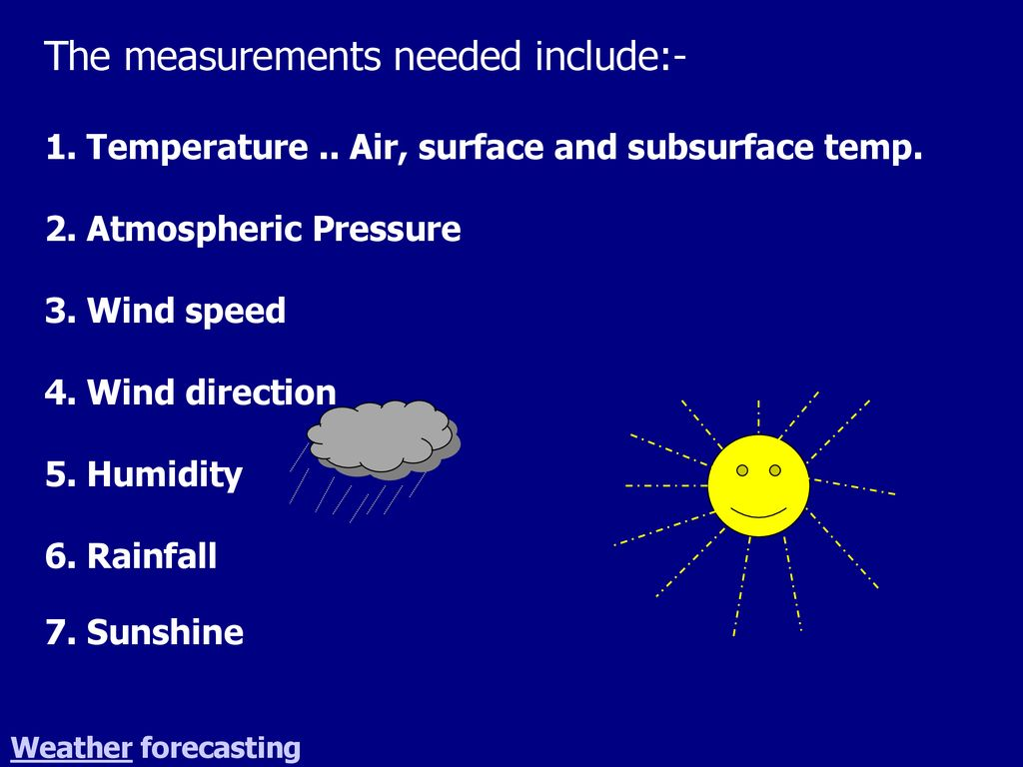

Slide 5
Procedure of Weather forecasting
The weather forcasting has now become a science and it is performed by adopting the following procedures(steps):
1. recording of weather data ( temperature, pressure, wind speed and direction, cloud forms, humidity etc.)
2. collection of weather data from weather recording( observations centers) stations scattered world over including both land and ocean surfaces
3. transmission of weather data collected from major weathr stations to sub centers.

Slide 6
Types of Weather Forecasting
On the basis of duration of the validity of forecasts into three types as follows:
1. Short range weather forecasts
2. Medium range weather forecasts
3. Long range weather forecasts

Slide 7
Types of Weather forecasting
Short range weather forecasts are predictions made between one and seven days before they happen.
Medium range weather forecasts are usually given between one week and four weeks in advance.
Long range weather forecasts are given between one month and a year in advance.

Slide 8
Tools Used for Weather Forecasting
Barometer : to measure air pressure
Radar: to measure the locations and speed of
clouds
Thermometers : to measure temperature
Computer models : to process data accumulated
from these instruments

Slide 9
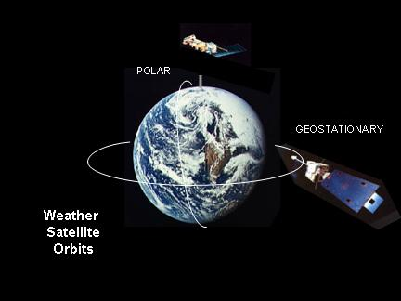
Weather Satellites
A weather satellite or meteorological satellite is a type of Earth observation satellite that is primarily used to monitor the weather and climate of the Earth. Satellites can be polar orbiting, or geostationary.

Slide 10
Weather Satellites
(on the basis of orbital paths)
Same rate of movement around the earth as that of the rotational speed of the earth.
These are fixed at the altitude of 35,786 kilometers from the sea level
These are called High altitude satellites
Example: ATS series and GOES series weather satellites

Slide 11
Conclusion
In summary, the use of precision agriculture in weather forecasting can helps farmers make more accurate management decisions, as well as give them economic benefits

Slide 12


